Slide 1
Yr 10 Week 1
Algebra
Gradient review
K. Farmer

Slide 2
Success Criteria
You will know you are successful in achieving the objective by…
Locate the gradient in an algebraic equation.
Demonstrate how to plot a line of a distinct gradient.

Slide 3

My Linear Relationships Interactive Notebook
Name
Class
Teacher
Semester 2
Term 4
1

Slide 4

Interactive Notebooks!
Cover Page
Contents Page
Glossary
24/7/30
EQ
Questions
Notes
Summaries
Work page
Presentation!!!
Your book, your responsibility!

Slide 5
Contents
Glossary or Formula Page
Page
Date
Description
For example
Linear: ___________
Origin: ___________
Coordinates: __________
2
3

Slide 6

24
7
30
Tasks
24
7
30
Essential Question
Complete the tasks on this side (left) of your page
You should be ticking these off!
Questions
Notes
Write your notes on this side (right) of your page
Summary
Have YOU been doing your summaries?
Your book, your responsibility!

Slide 7
25c Pyramid
In this AVID activity, split up into pairs and decide who is ‘A’ and who is ‘B’
Person A needs to face towards the board and Person B needs to face away
3 words will be displayed on the board. Person A needs to get Person B to say that word (by explaining it)
Person A cannot use the word itself or describing how it’s spelt (you can’t say it starts with the letter…)
Person B cannot peak!!!
As soon as the person has got all 3 words (you can do them in any order), both people need to sit down

Slide 8
First set of words
Car
Pen
Variable
Hint: Letters that represent unknown numbers

Slide 9
Second set of words
Duck
Calculator
Equation
Hint: Has an equal sign and variables

Slide 10
Third set of words
Perth
Interactive Notebook
Graph
Hint: How we display data

Slide 11
Fourth set of words
Spoon
Ruler
Straight Line
Hint: What we use a ruler for, not curved

Slide 12
Hook
Slope Dood video
https://www.youtube.com/watch?v=ZcSrJPiQvHQ

Slide 13
24
7
30
Date
Gradient
EQ – What is Gradient?
What is gradient?

Slide 14
24
7
30
Date
Gradient
EQ – What is Gradient?
What is gradient?
The gradient of a line is a measure of its slope.

Slide 15
24
7
30
Date
Gradient
EQ – What is Gradient?
What is gradient?
The gradient of a line is a measure of its slope.
It is a number that shows the steepness of a line.

Slide 16
24
7
30
Date
Gradient
EQ – What is Gradient?
What is gradient?
The gradient of a line is a measure of its slope.
It is a number that shows the steepness of a line.
It is calculated by knowing how far a line rises or falls (called the rise) within a certain horizontal distance (called the run).

Slide 17
24
7
30
Date
Gradient
EQ – What is Gradient?
What is gradient?
The gradient of a line is a measure of its slope.
It is a number that shows the steepness of a line.
It is calculated by knowing how far a line rises or falls (called the rise) within a certain horizontal distance (called the run).
The gradient is equal to the rise divided by the run.

Slide 18
24
7
30
Date
Gradient
EQ – What is Gradient?
What is gradient?
The gradient of a line is a measure of its slope.
It is a number that shows the steepness of a line.
It is calculated by knowing how far a line rises or falls (called the rise) within a certain horizontal distance (called the run).
The gradient is equal to the rise divided by the run.
The letter m is used to represent gradient.

Slide 19
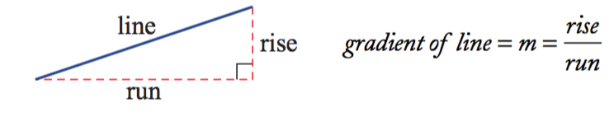
24
7
30
Date
Gradient
EQ – What is Gradient?
What is gradient?
The gradient of a line is a measure of its slope.
It is a number that shows the steepness of a line.
It is calculated by knowing how far a line rises or falls (called the rise) within a certain horizontal distance (called the run).
The gradient is equal to the rise divided by the run.
The letter m is used to represent gradient.

Slide 20
24
7
30
Date
Gradient
EQ – What is Gradient?
What is gradient?
The gradient of a line is a measure of its slope.
It is a number that shows the steepness of a line.
It is calculated by knowing how far a line rises or falls (called the rise) within a certain horizontal distance (called the run).
The gradient is equal to the rise divided by the run.
The letter m is used to represent gradient.
Engineers apply their knowledge of gradients when designing roads, bridges, railway lines and buildings.

Slide 21
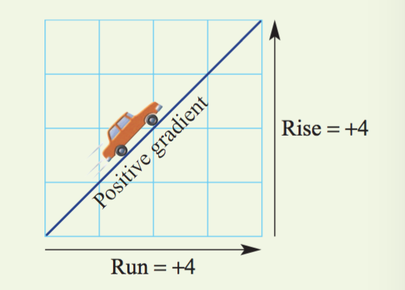
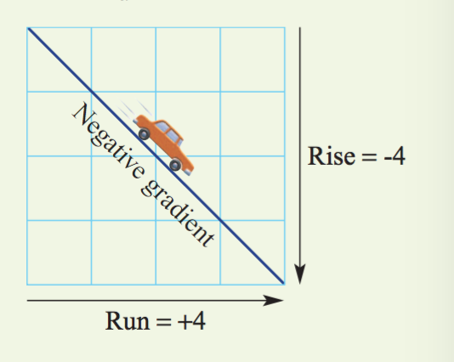
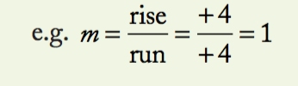
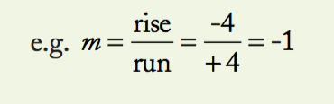
24
7
30
Date
Gradient
EQ – What is Gradient?
Important Note: Always move from left to right when considering the rise and the run.
If the line slopes up from left to right, the rise is positive and the gradient is positive.
If the line slopes down from left to right, the rise is considered to be negative and the gradient is negative.

Slide 22
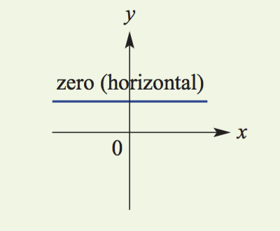
24
7
30
Date
Gradient
EQ – What is Gradient?
The gradient can also be zero (when a line is horizontal) and undifined (when a line is vertical).

Slide 23
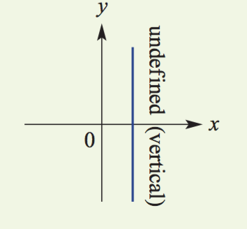
24
7
30
Date
Gradient
EQ – What is Gradient?
The gradient can also be zero (when a line is horizontal) and undefined (when a line is vertical).

Slide 24
Guided practice
Slope Foldable - Work through as a class.

Slide 25
Check for understanding
Completion of gradient foldable
Notes:
Check for understanding

Slide 26
Activity
Gradient revision questions as attached.
Notes:
Independent practice

Slide 27
Closure activity
Exit Pass Attached.
Notes:
Closure

Slide 28
Homework
Review your notes and write a summary answering the essential question.

